Slide 1

INTRODUCTION

Slide 2
Agenda
Introduction
Need and Benefits of HTML
Setup
Browser
BOM & DOM
DOCTYPE
Character encoding
<Script>
<Link>
HTML 5 documents & comments

Slide 3

Introduction HTML-5

Slide 4
HTML5 is the latest and most enhanced version of HTML.
Technically, HTML is not a programming language, but rather a markup language.
HTML stands for Hyper Text Markup Language
HTML is the standard markup language for creating Web pages
HTML describes the structure of a Web page
HTML consists of a series of elements
HTML elements tell the browser how to display the content.

Slide 5

Needs and benefits of HTML 5

Slide 6
Needs
HTML5 introduces a number of new elements and attributes that can help you in building modern websites.
New Semantic Elements,Forms 2.0 ,Persistent Local Storage,WebSocket,Server-Sent Events,Geolocation etc.
Legacy/Cross Browser Support popular browsers all support HTML5 (Chrome, Firefox, Safari IE9 and Opera).
Better Interactions.
Smarter Storage
Video and Audio Support

Slide 7
Benefits
All browsers supported.
More device friendly.
Easy to use and implement.
HTML 5 in integration with CSS, JavaScript, etc can help build beautiful websites.

Slide 8

Setup

Slide 9
How to Set Up a Web Page with HTML5
An HTML file is a text file, so to create an HTML file we can use any text editors.
Use any HTML Development tool like Sublime Text 3,Vim,Notepad++, etc.
We use Eclipse IDE for Java EE Developers which adds support for HTML5 development.
Save your file with the .html extension.
You can then load your file into a browser to see how it looks.

Slide 10

Browser

Slide 11
The latest versions of Apple Safari, Google Chrome, Mozilla Firefox, and Opera all support many HTML5 features and Internet Explorer 9.0 will also have support for some HTML5 functionality.
The mobile web browsers that come pre-installed on iPhones, iPads, and Android phones all have excellent support for HTML5.

Slide 12

BOM & DOM

Slide 13
HTML DOM
DOM stands for Document Object Model.
It is a standard defined by W3C (World Wide Web Consortium).
DOM is a programming interface (API) for representing and interacting with HTML, XHTML and XML documents.
It organize the elements of the document in tree structure (DOM tree) and in the DOM tree, all elements of the document are defined as objects (tree nodes) which have properties and methods.
When a web page is loaded, the browser creates a DOM tree for all the objects (Html elements) of that page.
The HTML DOM is a fully object-oriented representation of your web page and in HTML DOM each and everything is a node.

Slide 14
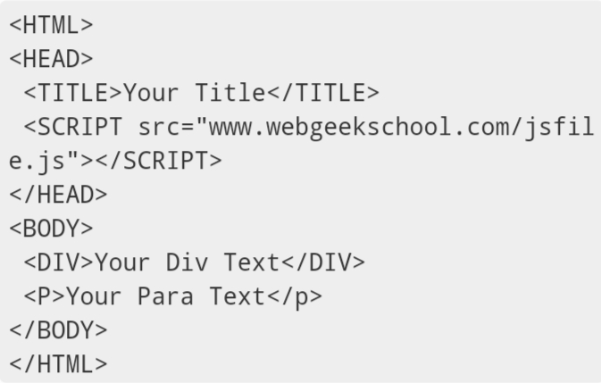

Slide 15
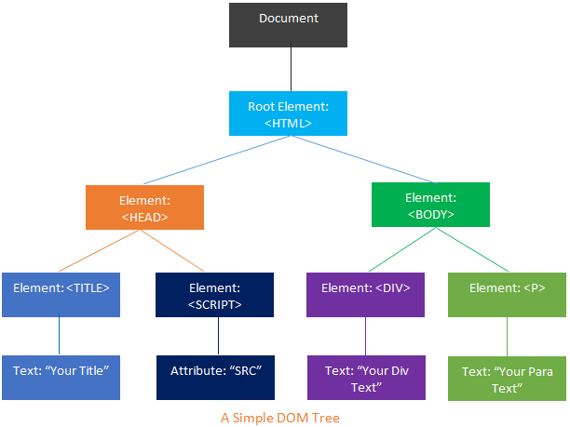

Slide 16
BOM
BOM stands for Browser Object Model.
Unlike DOM, there is no standard defined for BOM, hence different browsers implement it in different ways.
Typically, the collection of browser objects is collectively known as the Browser Object Model.
BOM main task is to manage browser windows and enable communication between the windows.
Each HTML page which is loaded into a browser window becomes a Document object and document object is an object in the BOM.
You can say BOM is super set of DOM. BOM has many objects, methods, and properties that are not the part of the DOM structure.

Slide 17
The important BOM objects are as:
document
location
history
navigator
screen
frames

Slide 18

DOCTYPE

Slide 19
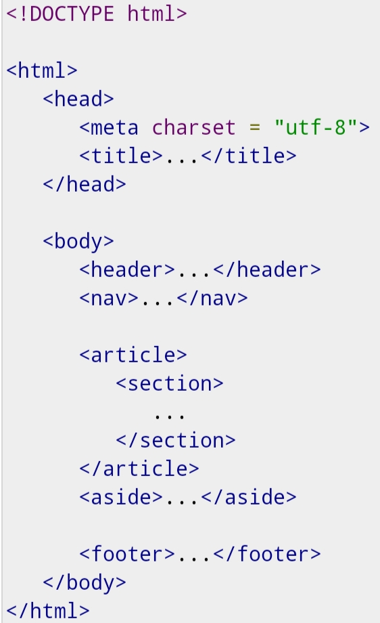

Slide 20
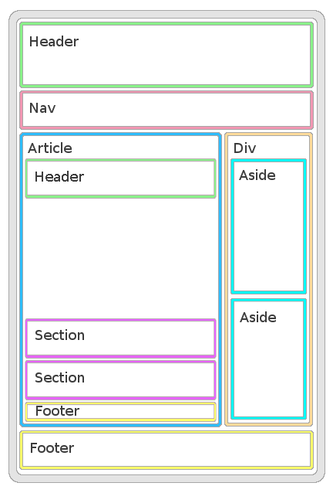

Slide 21
<!DOCTYPE> declaration represents the document type, and helps browsers to display web pages correctly.
It must only appear once, at the top of the page (before any HTML tags).
HTML 5 authors would use simple syntax to specify DOCTYPE as follows −
<!DOCTYPE html>
The above syntax is case-insensitive.

Slide 22

Character Encoding

Slide 23
HTML 5 authors can use simple syntax to specify Character Encoding as follows −
<meta charset = "UTF-8">
UTF-8 is a variable width character encoding which covers almost all of the characters and symbols in the world.
ANSI (Windows-1252) was the original Windows character set, which supported 256 different character codes.
Because ANSI and ISO-8859-1 were so limited.The default character encoding for HTML5 is UTF-8.

Slide 24

<script>

Slide 25
The <script> tag
It's common practice to add a type attribute with a value of "text/javascript" to script elements as follows −
<script type = "text/javascript" src = "scriptfile.js"></script>
HTML 5 removes extra information required and you can use simply following syntax −
<script src = "scriptfile.js"></script>

Slide 26

<link>

Slide 27
The <link> tag
So far you were writing <link> as follows −
<link rel = "stylesheet" type = "text/css" href = "stylefile.css">
HTML 5 removes extra information required and you can simply use the following syntax −
<link rel = "stylesheet" href = "stylefile.css">

Slide 28

HTML 5 Document, Comments

Slide 30
HTML5 Document
section − This tag represents a generic document or application section. It can be used together with h1-h6 to indicate the document structure.
article − This tag represents an independent piece of content of a document, such as a blog entry or newspaper article.
aside − This tag represents a piece of content that is only slightly related to the rest of the page.
header − This tag represents the header of a section.

Slide 31
footer − This tag represents a footer for a section and can contain information about the author, copyright information, et cetera.
nav − This tag represents a section of the document intended for navigation.
dialog − This tag can be used to mark up a conversation.
figure − This tag can be used to associate a caption together with some embedded content, such as a graphic or video

Slide 32
HTML Comment Tags
HTML comments are not displayed in the browser, but they can help document your HTML source code.
You can add comments to your HTML source by using the following syntax:
<!-- Write your comments here -->
Notice that there is an exclamation point (!) in the start tag, but not in the end tag

Slide 33
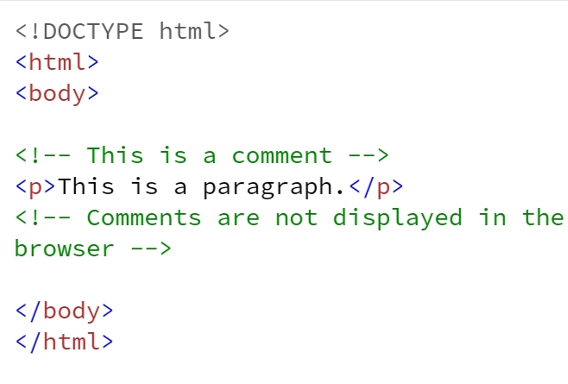



Slide 34
Sample code
<!DOCTYPE html> <html> <head> <title>The basic building blocks of HTML</title> </head> <body> <h2>The building blocks</h2> <p>This is a paragraph tag</p> <p style="color: red">The style is attribute of paragraph tag</p> <span>The element contains tag, attribute and content</span> </body> </html>

Slide 35
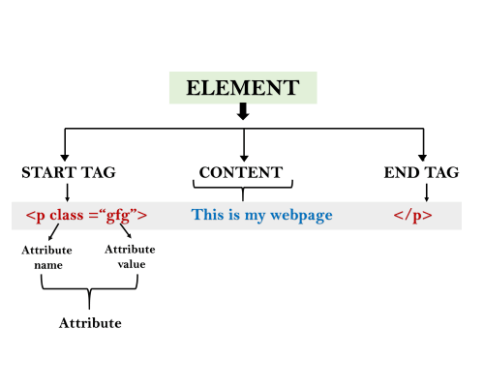

Slide 36



